Slide 1
Analyzing Local Market Trends to Predict Maryland Property Prices
Group A: Justin Mejia, Matthew Rutigliano, Emilee Sheaffer

Slide 2
Agenda
Background - & Data
Analysis
Framework
Market
Insights
Conclusion

Slide 3
Motivation & Purpose
Motivation:
Our study investigates the factors that impact sales prices of housing in Maryland.
Purpose:
Effectively determine the variables that influence housing prices.
Build a model to accurately predict housing prices with specified factors (such as region, personal income, etc.)

Slide 4



Data Description
Objective: To study the effects of average personal income and regional differences on home sales
Data Collection Sources:
Maryland Board of Realtors
Monthly updates on home sales by county
Includes units sold, average and median prices, inventory, and days on market
U.S. Bureau of Economic Analysis (BEA)
Yearly income data per county
Income data for 2021 and 2022 (Used to calculate average for 2023 and 2024)
Maryland Office of Tourism
Geographical grouping of counties for regional impact

Slide 5
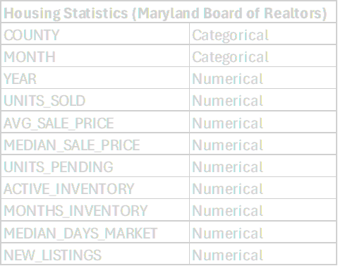
Data Variables
Personal Income Per Capita
INCOME | Numerical
Regions of Maryland
Housing Statistics
REGION | Numerical
Calculations
MONTH_YEAR | Numerical
QUARTER | Numerical
SEASON | Numerical

Slide 6
Analysis Framework

Slide 7
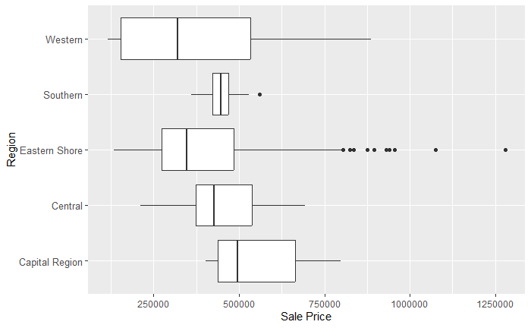
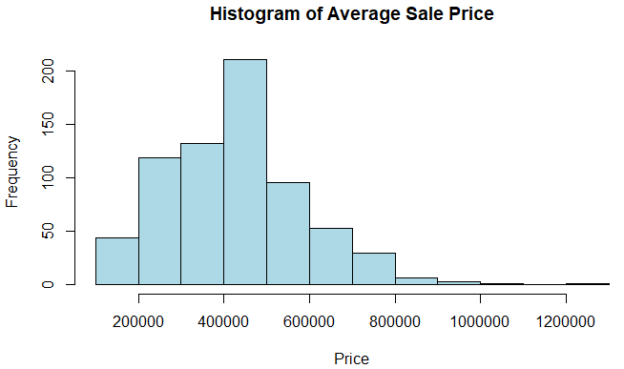
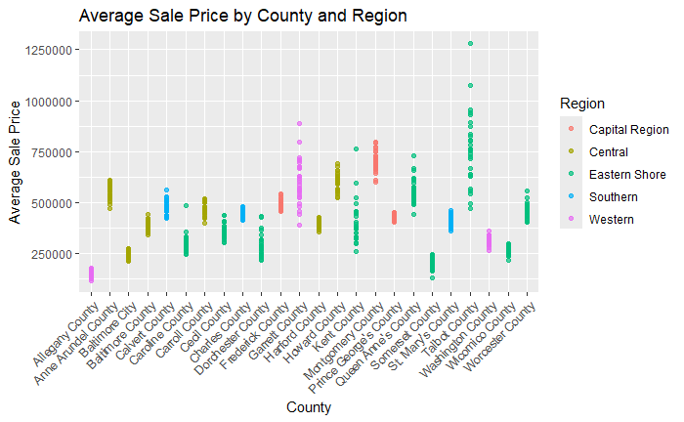
Data Exploration
Data Partitioning
Prevents overfitting
Training set: 70% / Test Set: 30%
Data Visualizations
Box Plot
Histogram
Scatter Plot

Slide 8
Initial Model Development
Key assumptions:
Linearity - Verified through residual plots
Independence - Sale prices assumed independent
Homoscedasticity - Assessed via scatterplots of residuals vs. fitted values
Normality of Errors - Analyzed performance by normalizing RMSE and MAE
Performance Evaluation:
Normality of Errors assumptions
Model demonstrated strong predictive accuracy: low RMSE and MAE values

Slide 9
Market Classification, Development and Evaluation
Classification of Hot & Cold “Market Status”
Engineered a target variable to classify a county
Hot Market: Average sale price above state median and median days on market below state median.
Cold Market: Does not meet “Hot” Market criteria.
Techniques to analyze classification:
Logistic Regression - Evaluated using confusion matrices & ROC curves.
K-Nearest Neighbors - Minimized validation error, ROC curves, Lift charts.
Linear Probability Model - Numeric conversion of target variable, error rates.
Classification Tree - Pruned for cross-validation results, decision-making process.
Random Forest - Ensemble classification, variable importance analysis.

Slide 10
Average Vs. Median Sale Price Decision
Analysis & Decision:
Comparison: Examined both metrics for centrality
Observation: Minimal skewness in the data
Rationale for Using Average:
Centrality: Similar mean and medians suggested that the average sale price accurately represented the central tendency.
Final Decision: Average for its application and reliable reflection of market trends.

Slide 11
Market Insights

Slide 12
What are the housing price ranges by region and county?
Within region variances in housing price larger than within county.
Particularly noticeable in price data from the Eastern Shore and Western Maryland.
How does this factor into our investigation into market indicators and housing prices?

Slide 13
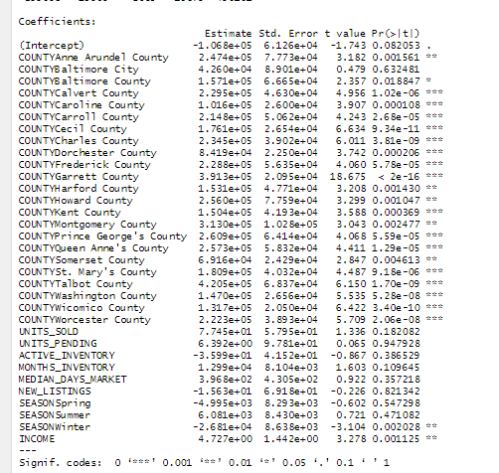
What are the market indicators that best predict housing sales prices in Maryland?
Ran three linear regression models using our training dataset to figure out which indicator predicted sales prices.
LRMPrice_0 - Ran all variables in our dataset against average housing sales price.
Results: Multicollinearity between county and region, month and season/quarter.
LRMPrice_1 - Excludes region level data.
Results: Counties, income, and winter season significantly related to sales prices.
LRMPrice_2 - Excludes county level data.
Results: Region level data not as significant as county level data. Income and winter season significantly related to sales prices.

Slide 14

Comparison of Linear Regression Models - RMSE and MAE
To further evaluate predictive performance of our models on unseen data….
Calculated normalized RMSE and MAE on our training and test data sets across all three linear regression models.
LRM_Price0 and LRM_Price1 see lower normalized RMSE and MAE - essentially tied.
Ultimately choose to use LRMPrice_1 to predict prices based on a given set of parameters (i.e. on County, Season, and Income).
Model | Train Normalized RMSE (% of avg price) | Test Normalized RMSE (% of avg price) | Train Normalized MAE (% of avg price) | Test Normalized MAE (% of avg price)
0 | 12.17 | 11.81 | 6.72 | 7.13
1 | 12.41 | 12.04 | 7.10 | 7.17
2 | 20.05 | 22.68 | 13.97 | 15.51
Notes:
Slide 14 - To further evaluate the predictive performance of each of our linear regression models on our training and test data sets, we calculated the normalized RMSE and MAE in order to compare all three linear regression models to each other.
Both LRM_Price0 and LRM_Price1 saw lower normalized RMSE and MAE - and were essentially tied with each other. On average, the predictions from these models were off by about 10% of the average housing price for RMSE and 6.5% for MAE.
LRMPrice_2 saw a larger normalized RMSE and MAE, with the predictions from our third model being off by about 19% of the average house price for the RMSE and 14% for the MAE.
Given our evaluation of each model’s predictive performance in minimizing the residuals between predicted and actual values, along with predicting average sales price, we ultimately determined that using LRMPrice_1, was the model we should use for predicting average housing sales price given a set of parameters.
Like I said earlier, county, season, and income, were the greatest determinants of sale prices in Maryland. Justin will now take you through how we generated price predictions using LRMPrice_1, in addition to our classification model of hot and cold housing markets by county

Slide 15

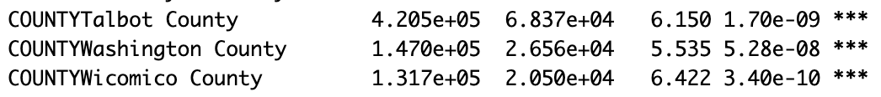
What will the average sale price be with specified criteria?
County - Is your dream home in a trendy spot or a hidden gem?
Season - Moving in the snow, yay or nay?
Income - How wealthy are your neighbors?
LPM 1

Slide 16
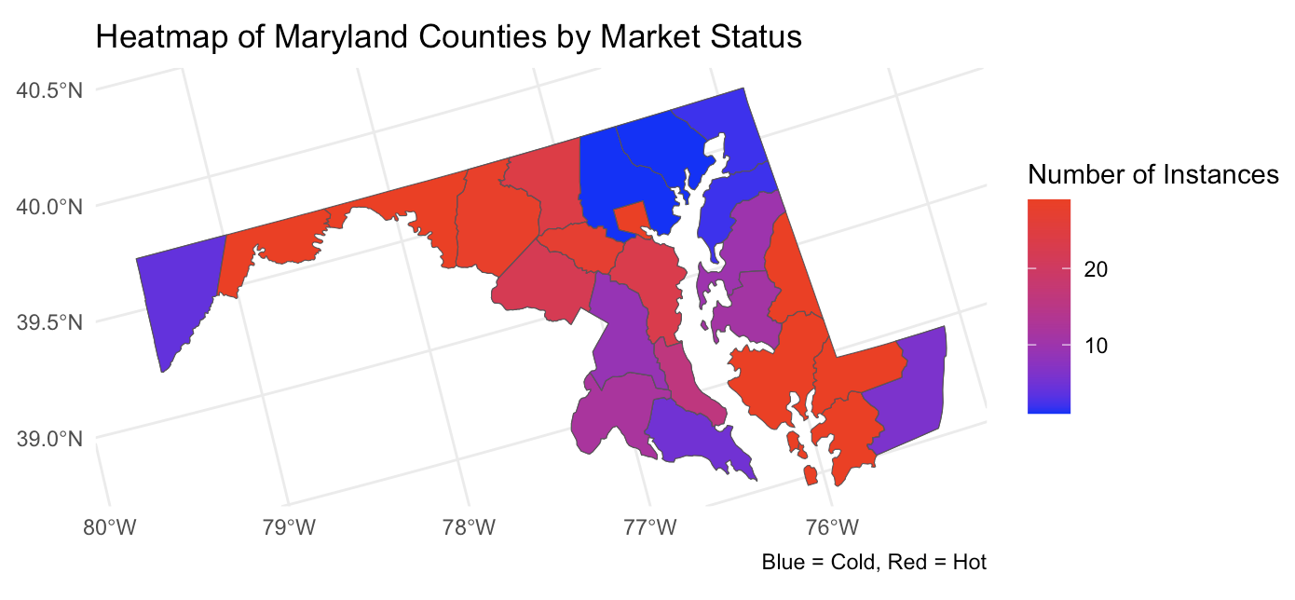
Which counties in Maryland are considered “hot” and “cold” markets by sales volume?

Slide 17
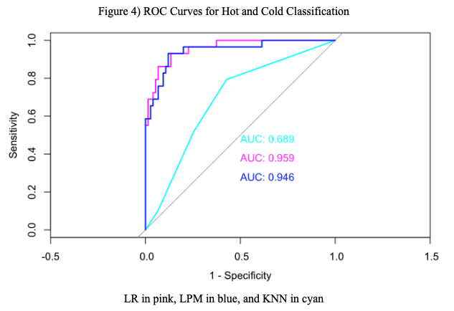
Analysis and Finding - LR, KNN, LPM
Model | Validation Error Rate | Test Error Rate
Logistic Regression | 10.60% | 7.60%
K-Nearest Neighbors | 8.7% | 11.4%
Linear Probability Model (LPM) | 12.50% | 9.50%

Slide 18
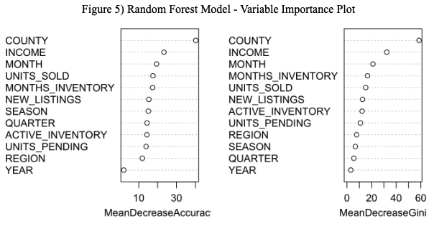
Analysis and Finding - Random Forest Model
Model | Test Error Rate | Specificity | Sensitivity | Overall Accuracy
Random Forest | 6.70% | 100% | 75.86% | 93.33%

Slide 19
Conclusion
Notes:
Powerpoint Image Sources:
Images
https://www.mdrealtor.org/About-Us
https://www.linkedin.com/company/bureau-of-economic-analysis

Slide 20
Conclusion
Maryland Housing Market Analysis (Jan 2022 - May 2024)
Key Predictors: County, season, and income significantly influence average housing sales prices.
County-Level Data: More determinant for prices than regional data.
Winter & Income: Winter negatively impacts prices, while income has a positive effect
Model Performance:
Linear Regression (LRMPrice_1): Best at predicting average sales price with no multicollinearity.
Random Forest: Best for classifying counties as hot or cold markets. A comprehensive view of price and turnover dynamics.
Recommendations:
Enhance feature engineering with economic, demographic, and geospatial data.
Introduce housing type data to better capture property specific market dynamics.
Expand dataset for a broader regional analysis.

